Slide 1
ECSE 211
Design Principles and Methods
TEAM 2 - WEEK 3

Slide 2
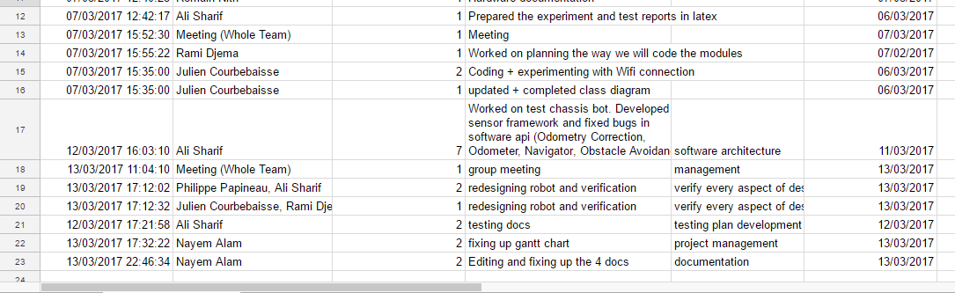
BUDGET - WEEK 2-3

Slide 3
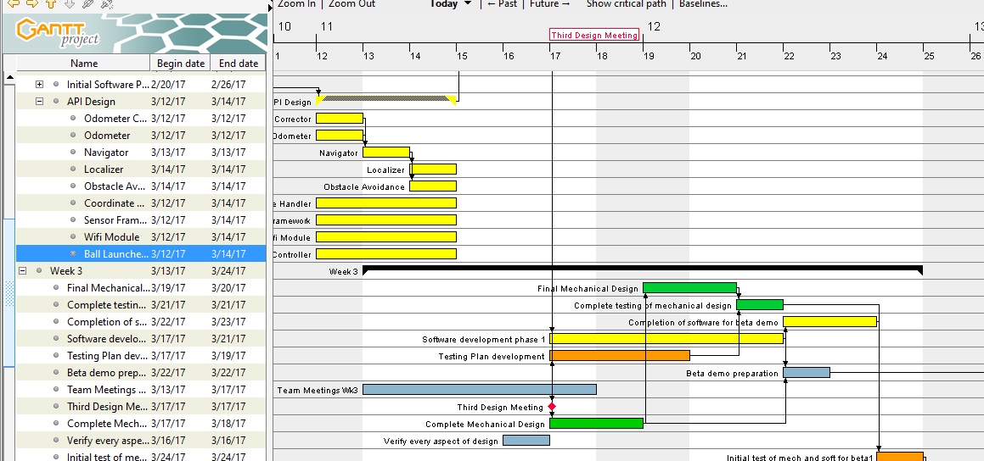
Progress as of March 12, 2017

Slide 4
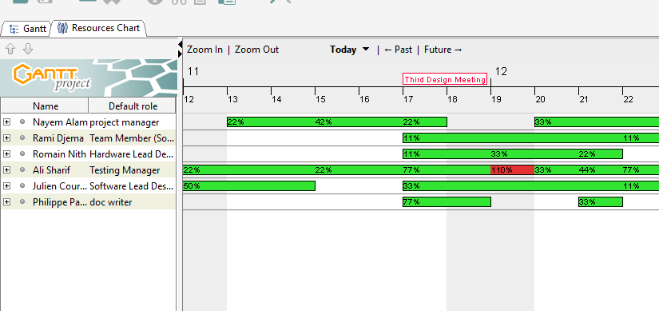
Resources as of March 12, 2017

Slide 5
Updates on documents
V3 - REQUIREMENTS DOCUMENT
Task is updated, now robot will go to the dispenser and then localize its position on the field
Upon receiving a ball, the robot will signal a single
V3 - CONSTRAINTS DOCUMENT
Minor hardware issues after first build
Some equipment not working as expected

Slide 6
Updates on documents
V3 - CAPABILITIES DOCUMENT
All doc font’s have been changed to Times New Roman, size 12.
All sections updated and edited, now with a table and looks neater
V3 - SYSTEMS DOCUMENT
Under ‘System Model’ section added the info for our first robot, i.e. long robot with catapult, all design related to hardware is under Mechanical Architecture and related to Software is Software Architecture
Firing Mechanisms updated: piston, elastic band thrower using two wheels
Under the ‘Hardware’ section added some info regarding first robot and how we plan to modify it
Added another components for Hardware, which is Red/Blue balls

Slide 7
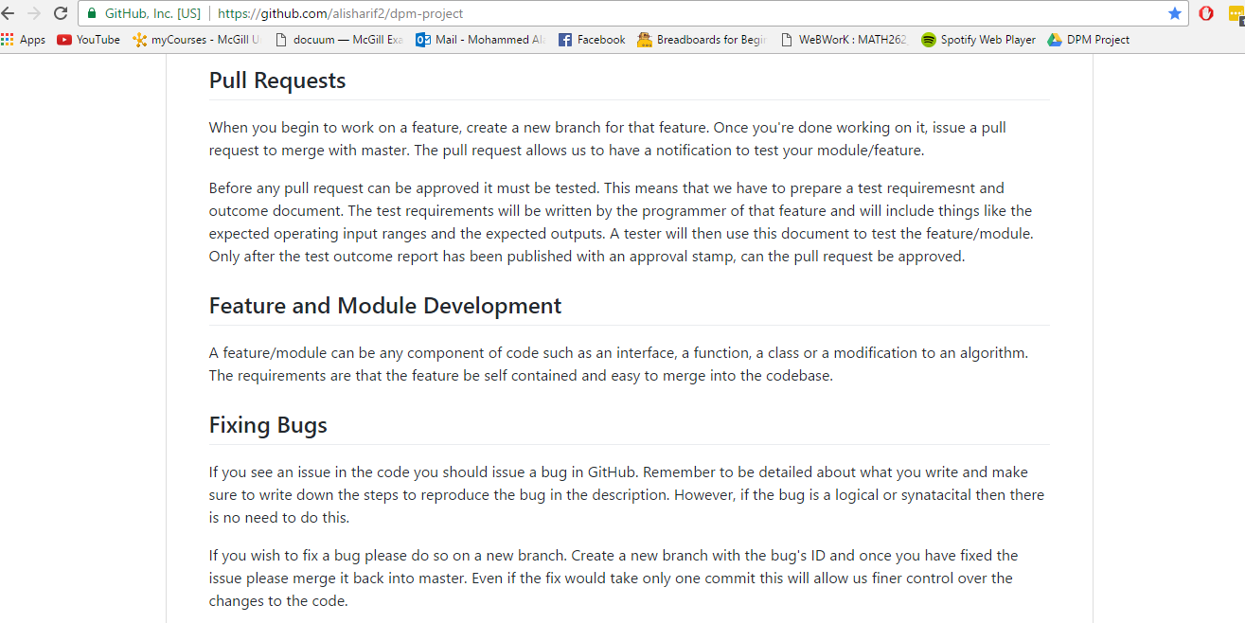
API DOC can be accessed on: [SAMPLE] https://github.com/alisharif2/dpm-project

Slide 8
Mechanical Design

Slide 9
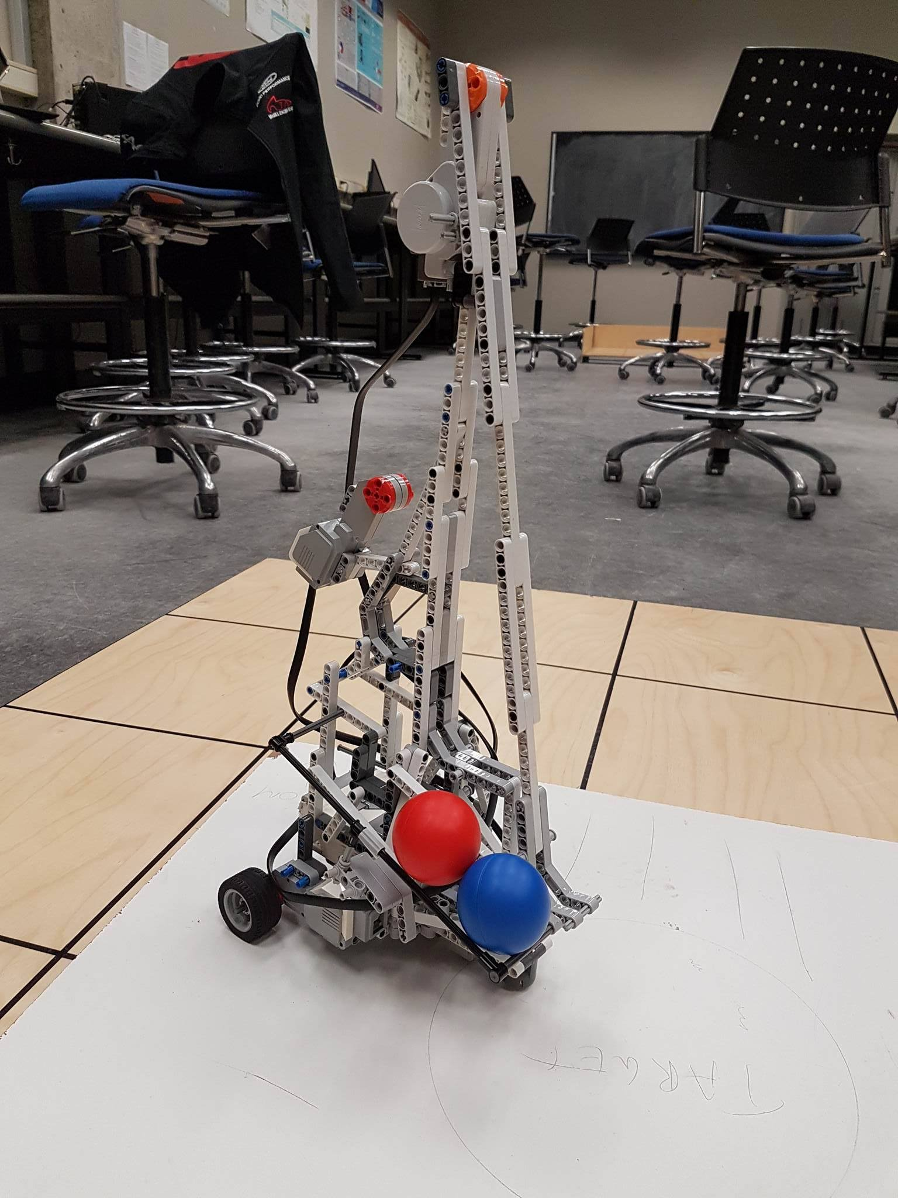
Catapult Launcher Mechanism
Pro:
Powerful enough for minimum requirement
Works
Cons:
Limited control of the firing range
Prone to imprecision due to the flex of vertical structure
Issue with reloading
Potential solution:
Investigate other launching mechanism
Solidify vertical structure and accommodate reload mechanism

Slide 10
Motorized Wheel Launcher
Pros:
Better control
Energy transferred faster to the ball
Cons:
Not powerful enough
Tried to add second pair of wheel but not enough torque (problem with gear ratio)

Slide 11
Defense Mechanism
Recap of ideas:
Cardboard Wall attached sideway
Raising Vertical Curtain made from soft material/fabric for easy deployment
Very little progress made, Attack Mechanism more pressing

Slide 12
Sensors and Hardware
x2 Wheel Motors
x2 Light Sensors for angle correction
x2 UltraSonic Sensors for wall detection
Undecided:
Motors for Attack/Defense Mechanism
1 or 2 EV3 Bricks depending on the need of additional Motor/Sensor Ports

Slide 13
Software Architecture

Slide 14
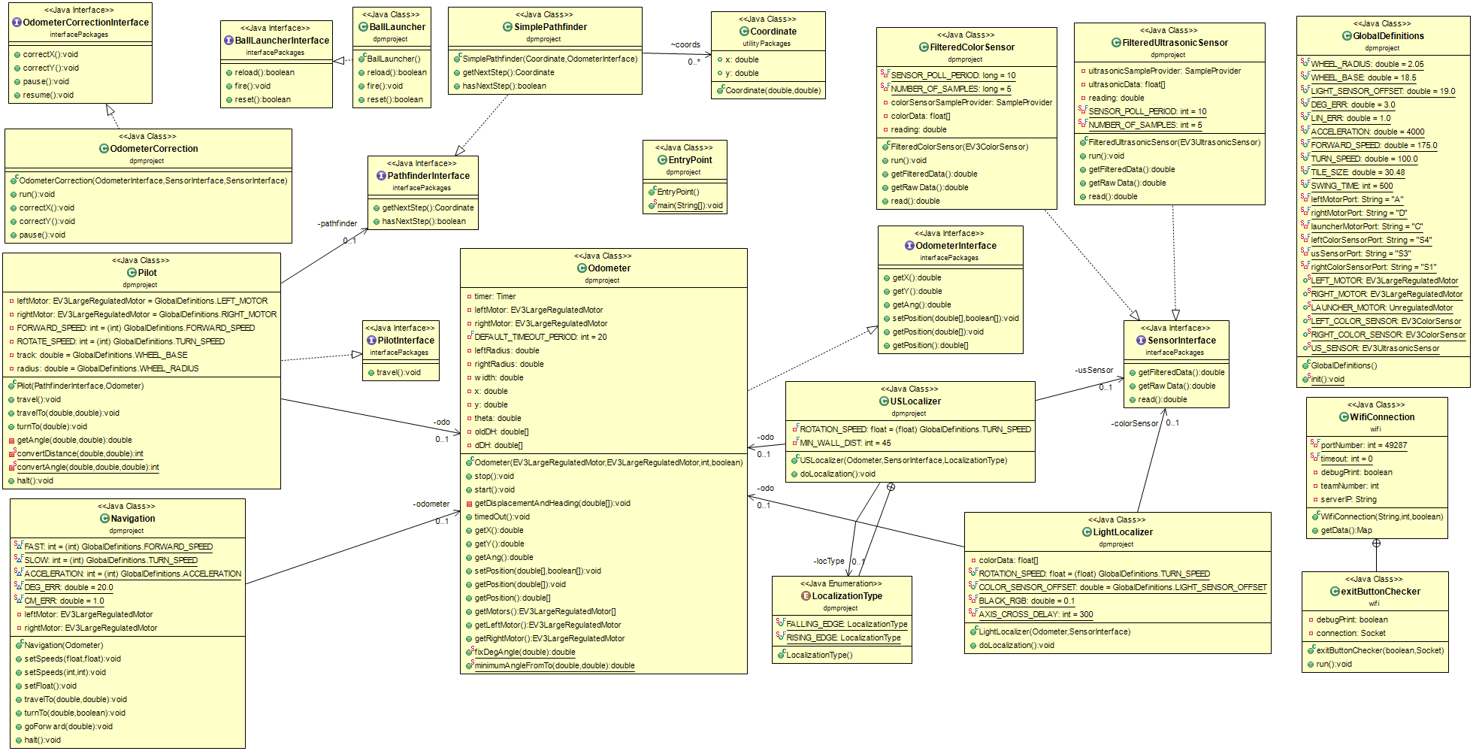
Class Hierarchy

Slide 15
Testing
Which codes worked?
Which didn’t work?
What were the issues?
What are our advantages?
Disadvantages?

Slide 16
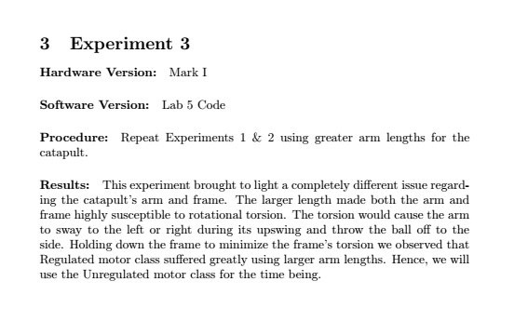
Testing Doc SAMPLE

Slide 17
Summary for progress so far regarding project
First prototype created
Odometry, Sensor, Localizer code has been done and tested on the sensors
Initial class hierarchy has been finalized
All four documents and all appropriate testing documents have been updated
Weekly and Global Time sheet all updated regularly
Gantt Chart updated and now finally makes sense relating it to the time sheet.
Gantt chart form a little changed, now added Week 1 through 5

Slide 18
Summary of Issues resolved so far by testing and modification
Summary of Issues yet to be resolved
Pilot and Pathfinder are working
Sensor framework with individual threading working
One of the sensors didn’t work and we also noticed many other hardware issues
Currently working on a new design that can be added to our preliminary design
New design? Might use catapult length and elastic band
Still need to ensure timing between light sensor pulses are measured accurately

Slide 19
Plans for the following week
Work on the Odometry Correction Code
Create a better pathfinder and improve pilot’s motor control
Look into reloading mechanism with dispenser
Prepare for Milestone II (DEMO): The robot has to be able to localize, navigate, avoid obstacles, find and shoot the ball on target
Update Documentation regularly alongside testing the robots

